Slide 1
Data Analytics Process
Application in Real Life Scenario Case Study / PPT
Scenario - I would like to travel to Goa and wanted to know which place,beach,hotels good to visit and activities to play

Slide 2

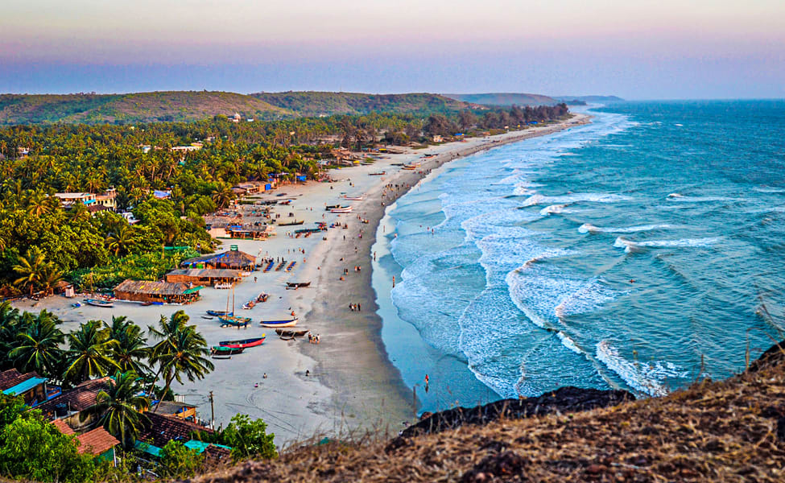
Description -
I wanted to travel Goa in next few months with my love ones and friends. So I have to researched which places,hotels,cafes,beaches & other things to stay, eat & play in Goa. I would like refresh myself with new things. For this I will used Data analytics process such as Plan,Prepare,Process,Analyze,Share and act.

Slide 3

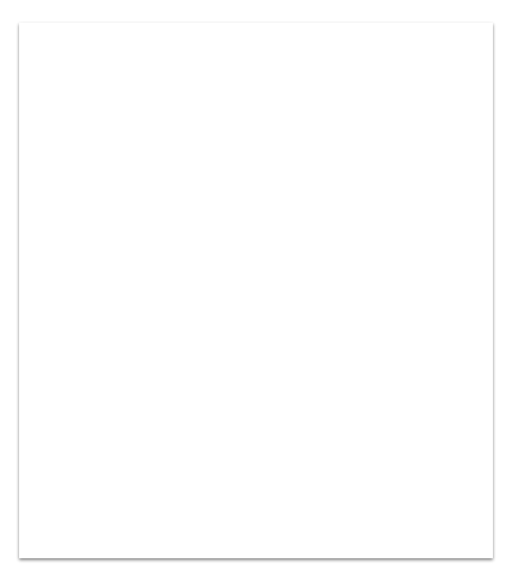
Plan
As I have decided to visit Goa so i need to research various hotels, food cafe,travel tickets etc. I will check which place i would like to visit first and how many days trip .
I will asked question to me that “is it really exciting for me” and “is it coming in to my budget” so i can travel more easily.

Slide 4
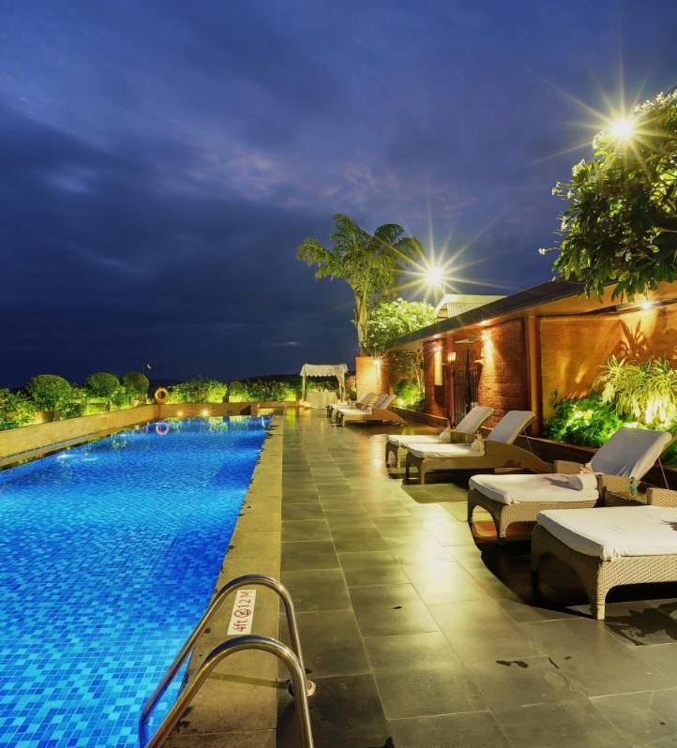
I will researched online on different platform like GoibGo. Make my trip to check hotel cost, food cost, shopping market places, beach hotels, sea view places and many more. I have to do shopping as well to get good attire.
Prepare
Tip
Use different mobile tools to make place for Goa trip if you are going with group.

Slide 5
Process -
I have gone different hotels website from make my trip and also called them to check exact availability & location nearby beaches.
I have sorted 2-3 hotels to stay in & places to visit.
Reference link -
https://www.tripadvisor.in/
https://www.booking.com/
https://www.agoda.com/
https://www.makemytrip.com/

Slide 6
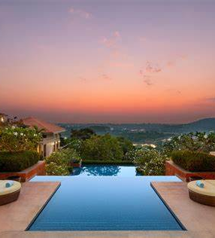
Analyze :
I have analyzed that sea view hotels are good to stay and swimming pool side as well. I’m vegetarian and also got an idea of hotels. Shopping market are also somehow good buy things.

Slide 7
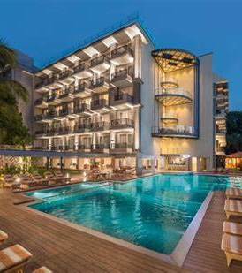
Share -
I have decided to stay in Le Meridien Hotel in calangute area near to calangute beach for 5 days.
Also I have purchase few clothe like shorts & tops to get a beach look and find out some hotels to get an idea of it.

Slide 8
I have book my Goa trip tickets and also hotels booking. I have got food coupons as well from instagram.
Looking for vacation now !!!
Act -

